Slide 1
DATAFLOW DIAGRAM

Slide 2
What is DFD?
DFD is the abbreviation for Data Flow Diagram. The flow of data of a system or a process is represented by DFD. It also gives insight into the inputs and outputs of each entity and the process itself. DFD does not have control flow and no loops or decision rules are present.

Slide 3
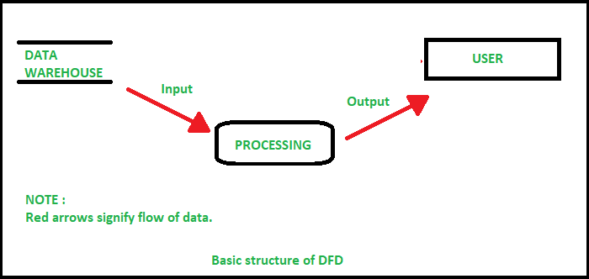
Structure of DFD

Slide 4
Restrictions for DFD
Each process should have at least one input and an output.
Each data store should have at least one data flow in and one data flow out.
Data stored in a system must go through a process.

Slide 5
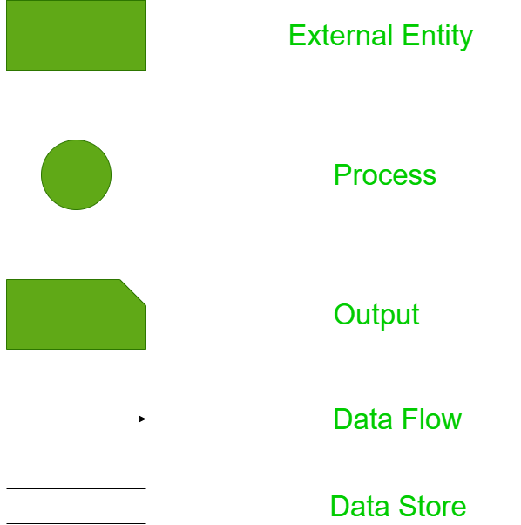
Components of DFD

Slide 6
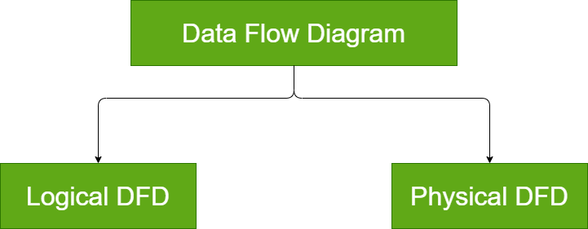
Types of DFD

Slide 7
Logical DFD:
Logical data flow diagram mainly focuses on the system process. It illustrates how data flows in the system. Logical DFD is used in various organizations for the smooth running of system. Like in a Banking software system
Physical DFD:
Physical data flow diagram shows how the data flow is actually implemented in the system.

